Slide 1
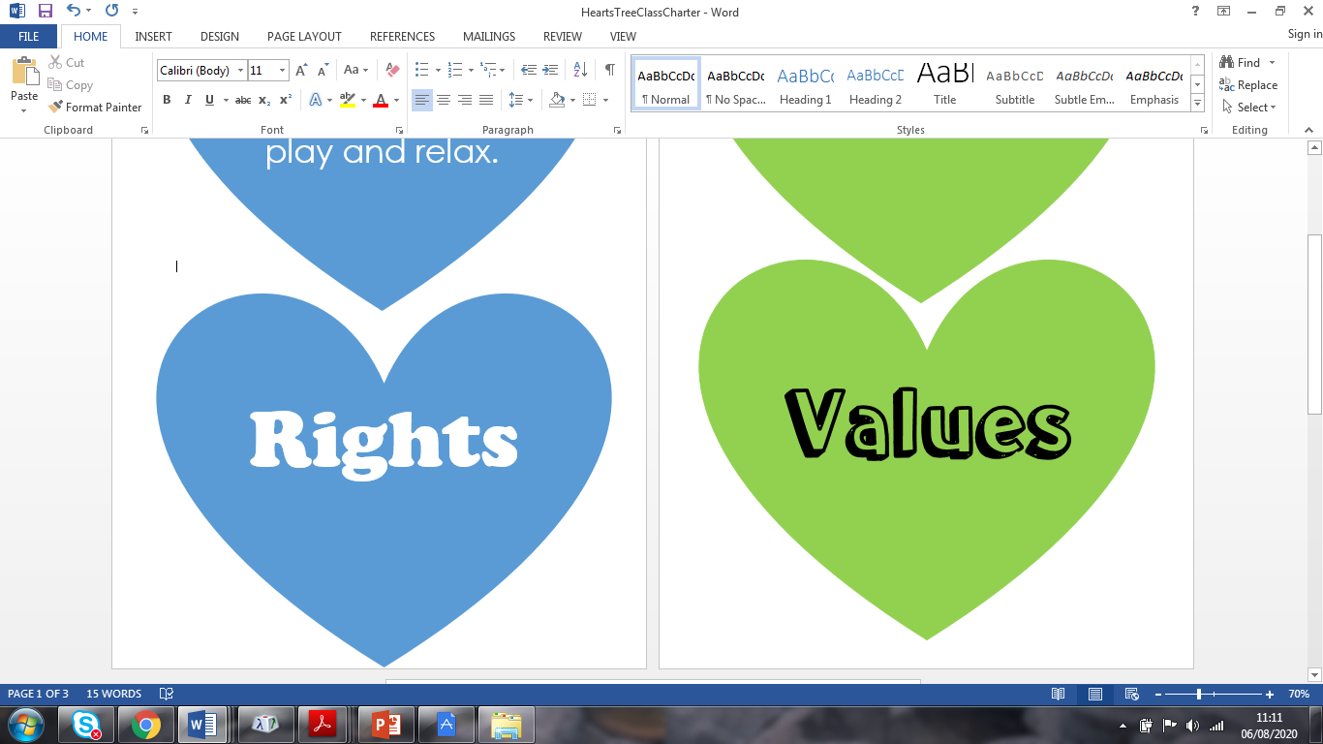



WALT: use the ‘Rights of a Child’ and ‘Oakfield Values’ to help us form our Playground Charter.

Slide 2

Siaradwch gyda partner...
What is a ‘right’?
Think about the difference between ‘wants’ and ‘needs’.
Can you name/remember any ‘rights’ you have as a child?
Think about our Class Charter!

Slide 3
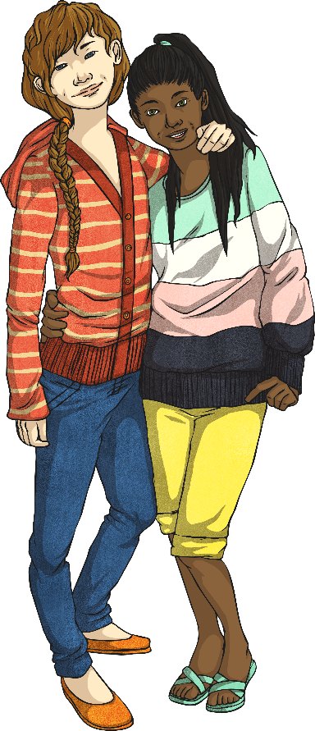
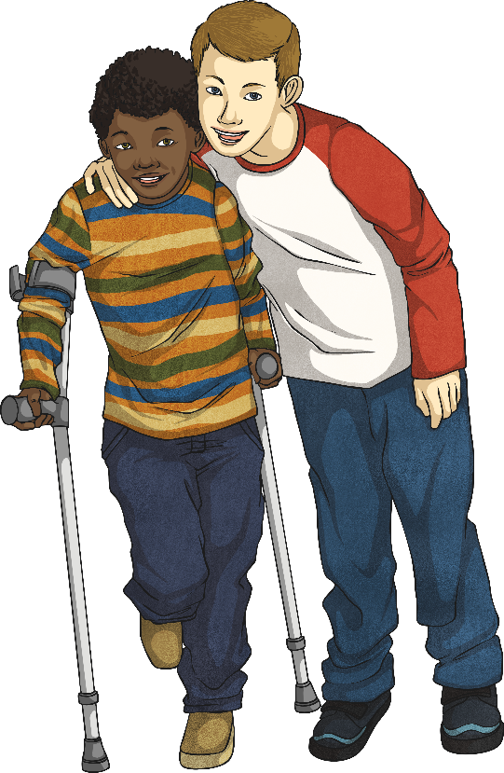
Respecting Rights at School
We all have rights.
It is important that our rights are respected everywhere, including at school.
We all need to make sure we respect our own rights and the rights of others (rights respecting).
This term, we will celebrate/focus on…
Article 19
The right to be safe.

Slide 4

Autumn Term (1)
Autumn Term (2)
Article 28
I have the right to
learn
Article 19
I have the right to be safe
Article 12
I have the right to be heard
Let’s click on our hearts to find out more about our rights.
Article 31
I have the right to
play and relax.
Article 24
I have the right to be healthy
NEXT

Slide 5
Autumn Term (1)
Autumn Term (2)
Article 28
I have the right to
learn
Article 19
I have the right to be safe
Article 12
I have the right to be heard
Let’s click on our hearts to find out more about our rights.
Article 31
I have the right to
play and relax.
Article 24
I have the right to be healthy
NEXT

Slide 6
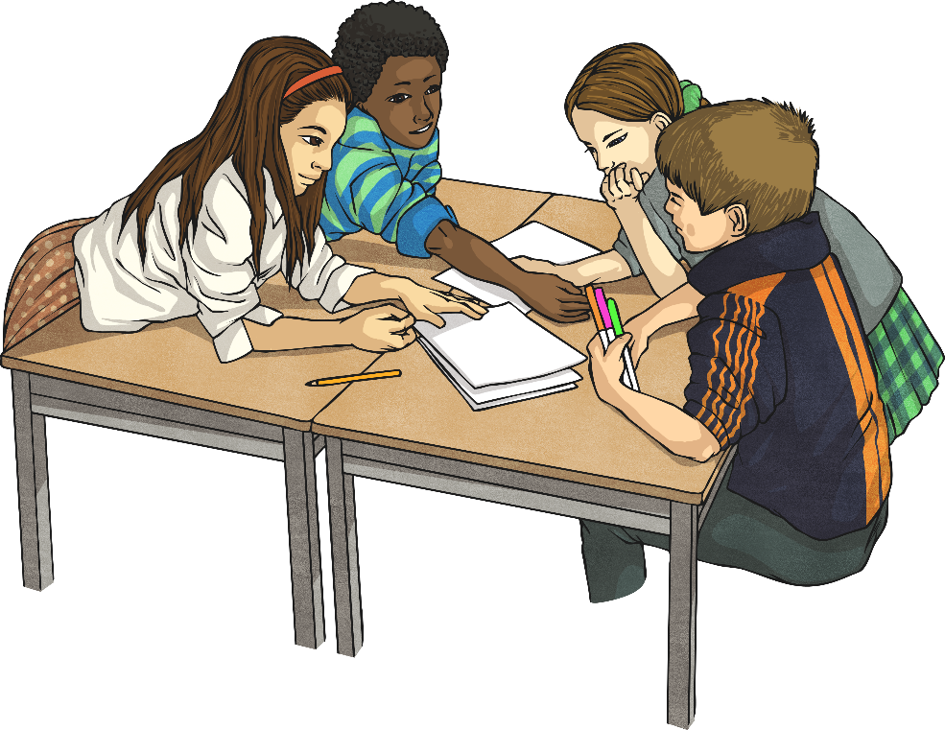
Respecting Rights at School
I have the right to learn.
My education should help me achieve my best and express my talents.
Rights Respecting: I will try my best and listen to others.
Rights Respecting: I will let other people get on with their work.
Gyda partner:
Share at least 2 more responsibilities linked to this right!
Go back!
<

Slide 7
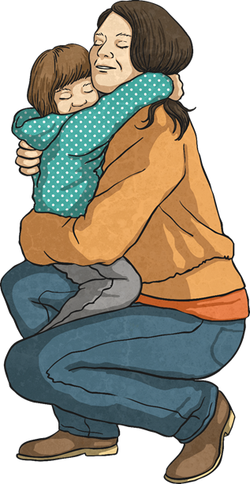
Respecting Rights at School
I have the right to be safe.
Children have the right to be protected and kept safe from all forms of bad treatment.
Rights Respecting: I will stay safe online.
Rights Respecting:I will move around the school safely.
Gyda partner:
Share at least 2 more responsibilities linked to this right!
Go back!
<

Slide 8
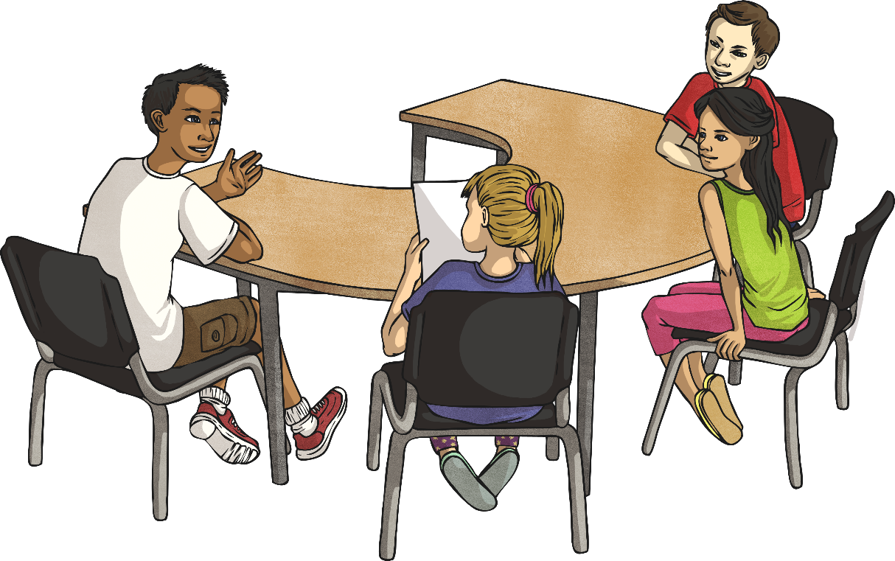
Respecting Rights at School
. I have the right to be heard, sharing my ideas and opinions as long as they respect the rights of others
Rights Respecting:I will respect this right by listening to others and respecting their views.
Gyda partner:
Share at least 2 more responsibilities linked to this right!
Go back!
<

Slide 9
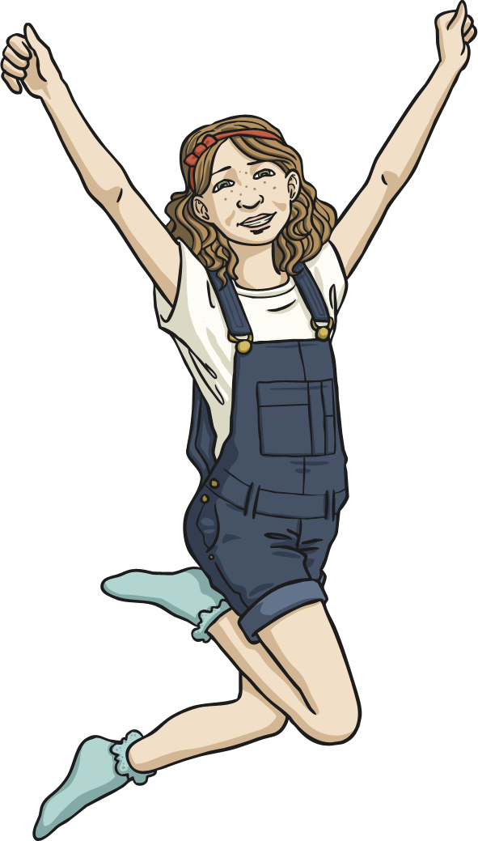
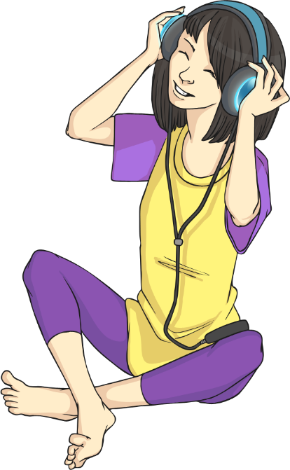
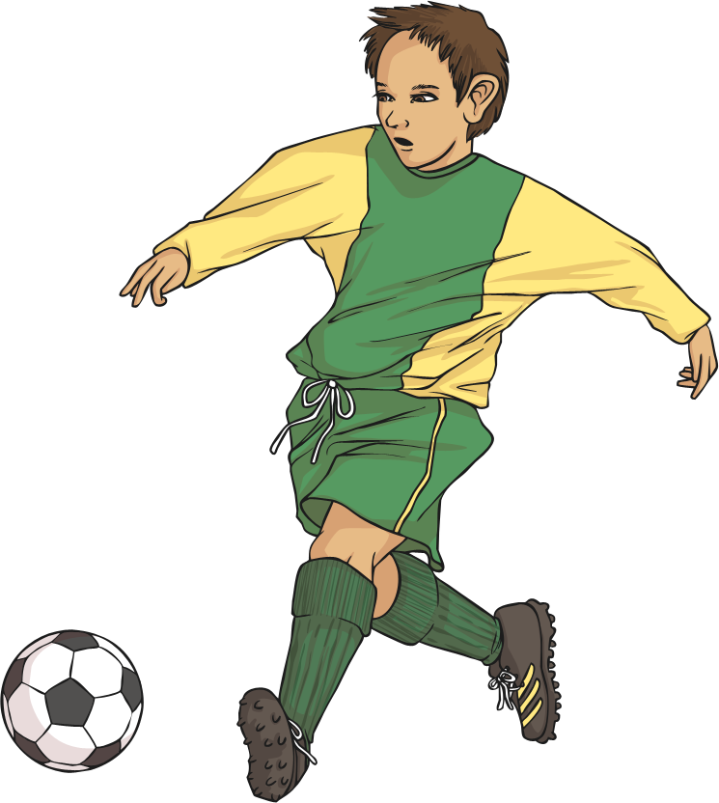
Respecting Rights at School
I have the right to play and relax.
Responsibility: I will respect this right by working hard in lessons, and playing and relaxing in my break times.
Gyda partner:
Share at least 2 more responsibilities linked to this right!
Go back!
<

Slide 10
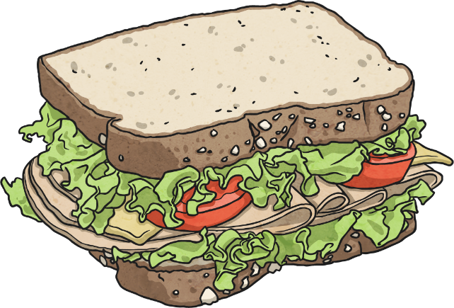
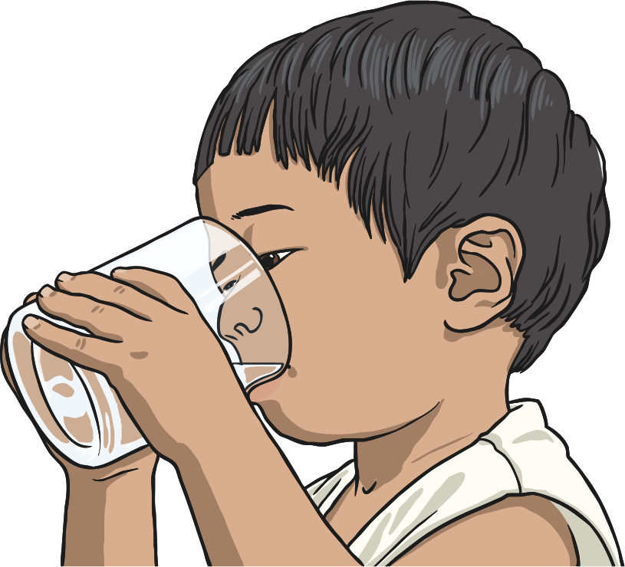

Respecting Rights at School
I have the right to be healthy.
Rights Respecting: I will make healthy choices and take care of myself, for example...
Rights Respecting: I will ensure I wash my hand regularly.
Gyda partner:
Share at least 2 more responsibilities linked to this right!
Go back!
<

Slide 11
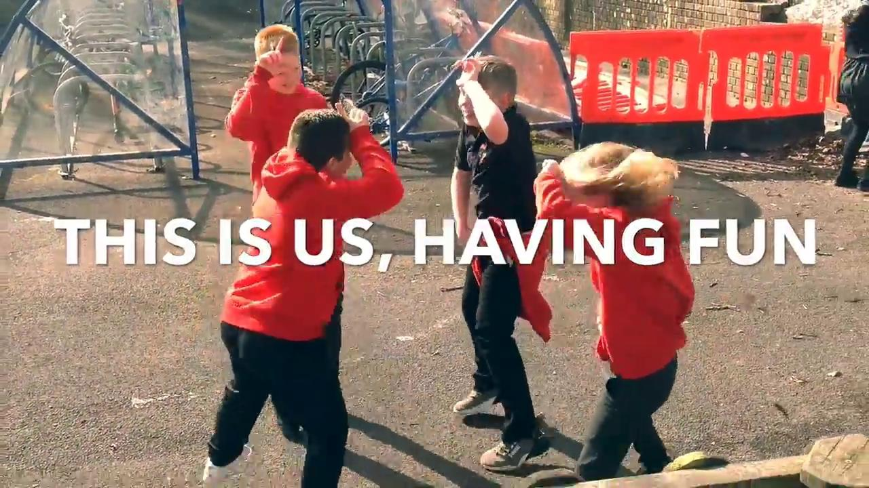
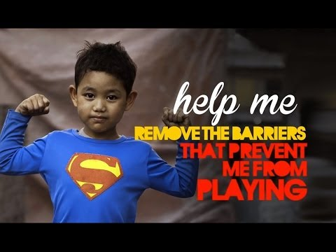
Article 31 - Every child has the right to play, relax and engage in cultural and artistic activities.
At Oakfield Primary School, we are very lucky to have many safe places, and opportunities to respect our right to play and relax!
We all have a responsibility to respect others’ right to play...

Slide 12
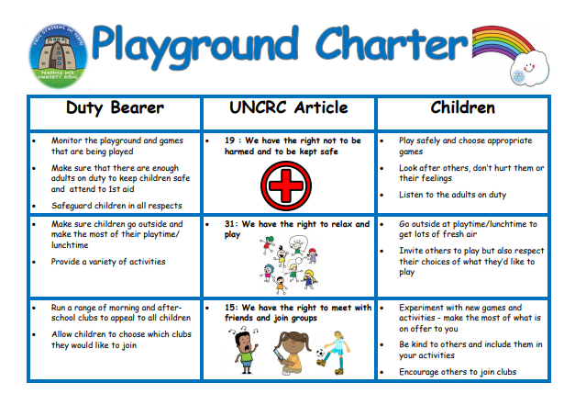
Playground Charter Ideas
WAGOLL
We’ve already used our Pupil Voice to form our Class Charter which we follow every day.
As a class, we are now going to think about ways that we can make sure we respect everybody’s rights on the playground.
Playground Charter
Example

Slide 13


Oakfield ‘Playground Charter’ Ideas
Year Group: 2 - Let’s add our ideas as a class
Rights (UNCRC Articles) | Children’s Responsibilities Pupils will respect this right by…. | Duty Bearers (Adults) Responsibilities Staff will respect this right by….
Article 15: The right to participate | Being kind to one and other Include others in our games | Support children to join in with activities and games
Article 19: The right to be safe and not harmed | Playing safely at our chosen activity | Supervising activities in the playground
Article 31: The right to play and relax | Look after our equipment (report anything broken to an adult) | Provide activities to access during play time

Slide 14
Oakfield ‘Playground Charter’ Ideas
Year Group: 3 - Let’s add our ideas as a class
Rights (UNCRC Articles) | Children’s Responsibilities Pupils will respect this right by…. | Duty Bearers (Adults) Responsibilities Staff will respect this right by….
Article 15: The right to participate | Being kind to one and other Include others in our games | Support children to join in with activities and games
Article 19: The right to be safe and not harmed | Playing safely at our chosen activity | Supervising activities in the playground
Article 31: The right to play and relax | Look after our equipment (report anything broken to an adult) | Provide activities to access during play time

Slide 15
Oakfield ‘Playground Charter’ Ideas
Year Group: 4 - Let’s add our ideas as a class
Rights (UNCRC Articles) | Children’s Responsibilities Pupils will respect this right by…. | Duty Bearers (Adults) Responsibilities Staff will respect this right by….
Article 15: The right to participate | Being kind to one and other Include others in our games | Support children to join in with activities and games
Article 19: The right to be safe and not harmed | Playing safely at our chosen activity | Supervising activities in the playground
Article 31: The right to play and relax | Look after our equipment (report anything broken to an adult) | Provide activities to access during play time

Slide 16
Oakfield ‘Playground Charter’ Ideas
Year Group: 5 - Let’s add our ideas as a class
Rights (UNCRC Articles) | Children’s Responsibilities Pupils will respect this right by…. | Duty Bearers (Adults) Responsibilities Staff will respect this right by….
Article 15: The right to participate | Being kind to one and other Include others in our games | Support children to join in with activities and games
Article 19: The right to be safe and not harmed | Playing safely at our chosen activity | Supervising activities in the playground
Article 31: The right to play and relax | Look after our equipment (report anything broken to an adult) | Provide activities to access during play time

Slide 17
Oakfield ‘Playground Charter’ Ideas
Year Group: 6 - Let’s add our ideas as a class
Rights (UNCRC Articles) | Children’s Responsibilities Pupils will respect this right by…. | Duty Bearers (Adults) Responsibilities Staff will respect this right by….
Article 15: The right to participate | Being kind to one and other Include others in our games | Support children to join in with activities and games
Article 19: The right to be safe and not harmed | Playing safely at our chosen activity | Supervising activities in the playground
Article 31: The right to play and relax | Look after our equipment (report anything broken to an adult) | Provide activities to access during play time

Slide 18


School Council
Playground Charter
Competition

Slide 19
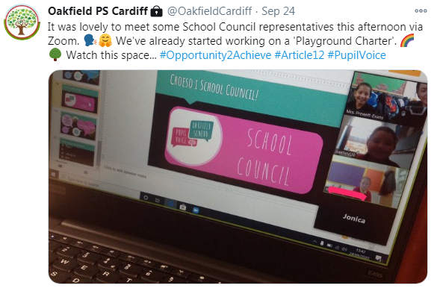
Competition Time!
Some Members of School Council met at the beginning of the year and decided that we would like to hold a competition to help us form our school Playground Charter. This will help us
include all of your ideas and respect your right
to be heard! The Playground Charter needs to
be child-friendly, eye-catching and
easy to read.
Task: Design/create a Playground Charter that lists our rights/responsibilities in the form of...
Option 1: An acrostic poem
Option 2: A Rights Respecting Rainbow
Option 3: Your own method!
School Council reps will choose the top 2 charters for their class.
The shortlist will then be sent to Mr. Harris and Mrs. Mears to decide on a 1st, 2nd and 3rd prize with our Y6 reps.

Slide 20
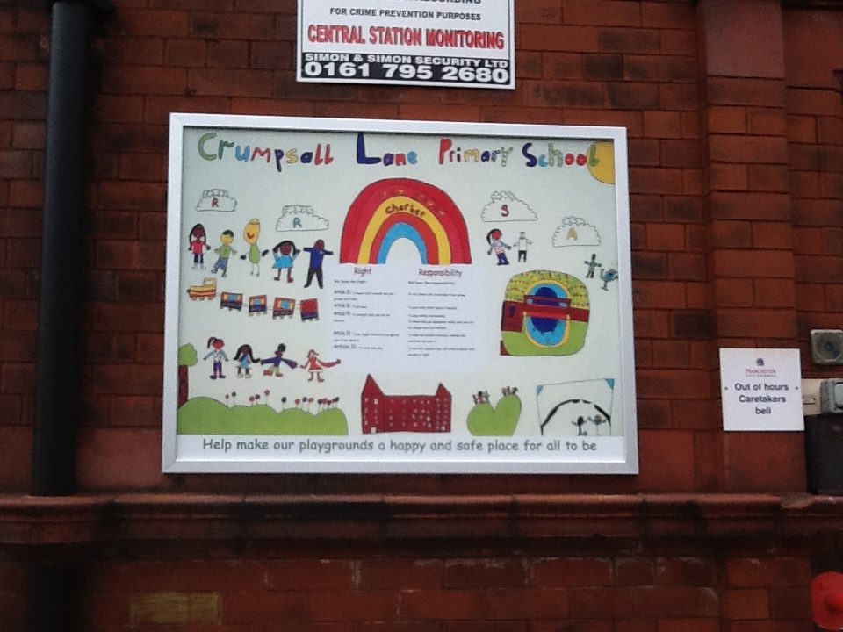
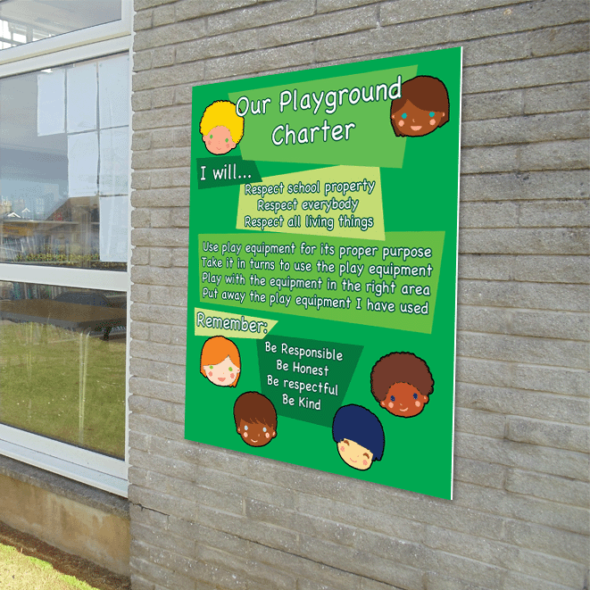
Perhaps your Playground Charter/ideas/illustrations will be displayed as a reminder for everyone in the playground...

Slide 21
Option 1 - Acrostic Poem
Here’s an example formed by School Council:
P
L
A
Y
T
I
M
E
P lay is our right, politeness is key.
L et others play with you. Look out for those who are lonely. Listen to your teachers!
A lways be friendly. Always tell a teacher if you are hurt. Always show kindness.
Y our safety matters!
Let’s decide on our steps for success if you choose this method.
MUST, SHOULD, COULD

Slide 22

Oakfield Primary School
Our Playground Charter
We have the right to...
Option 2 - Rights Respecting Rainbow
Here’s an example/idea!
There are only a number responsibilities listed. Yours should include more - let’s decide on a MUST as a class.
play
be safe
participate
Children
Adults
will respect these rights by...
will respect these rights by...
being kind and respectful to one and other
include others in games
share our equipment
listen to and follow instructions given by adults
supervising activities in the playground
support children to join in with games
model how to play with others
Let’s decide on our steps for success if you choose this method.
MUST, SHOULD, COULD

Slide 23



Sut ydych chi’n teimlo?
Dangoswch fi!

