Slide 1
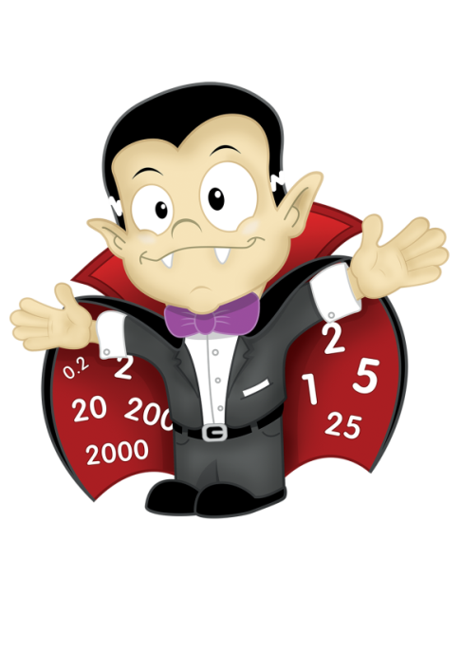
Using
Target Boards
in
Big Maths
EYFS Version

Slide 2

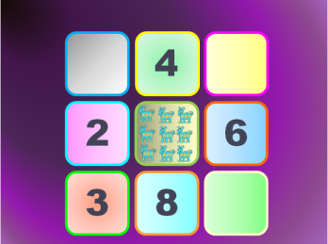
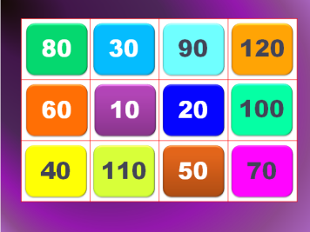
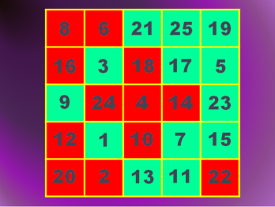
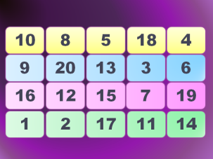
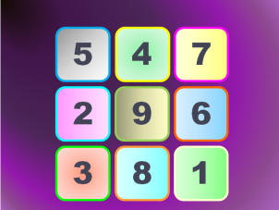

EYFS Target Boards: Teacher's Notes
Introduction
Target Boards are an extremely effective resource for developing children’s mental agility –helping to develop their enjoyment of ‘playing with numbers’ - and in improving their counting skills and also their confidence in using a range of mathematical vocabulary. They are simple to use and yet very versatile. Target Boards are just a collection of numbers or shapes on grids of different sizes. Teachers can design their own boards but there is also a starter set of animated boards presented as PowerPoint slides. There are versions also available for KS1, KS2 and KS3. They can be used successfully alongside resources such as counting sticks, number tracks or lines and washing lines. An accompanying resource - Developing Mathematical Language Labels – provides ideas for questions for Target Boards and washing lines. These questions provide an opportunity for children to communicate their reasoning and justify their answers.
Examples (Using grids of different sizes, ‘mixed-up’ numbers)
Who can read out the numbers in the first/second/third ……. /last line (or row)?
Look at the first line. Who can point to the smallest number? What about the biggest number?
Look at the second line. Who can put the numbers in order? Start with the smallest. Which numbers are missing? Which row/column will I find the number …?
Look at the second line. Which numbers are more than ten? Which numbers are less than ten?
Point to the numbers on the grid in order starting with the smallest. Say the numbers aloud.
Read the numbers starting from one corner and moving around the 3x3 grid in different ways.
What is one more/one less than each number?
Point to a number – what is the missing piece to make 10? In Big Maths we call these ‘Jigsaw Numbers’.
Double each number. Halve each number.
Choose any row or column and put the numbers in order starting with the smallest
Read the numbers starting from one corner and moving around the 3x4 grid in different ways.
Choose any row or column and put the numbers in order starting with the smallest
Choose a number, count forwards and backwards in multiples of 10 from this number.
Count on from any multiple of ten in steps of one.
Choose a number. How many tens?

Slide 3
Further Example (Starting with a blank grid and creating a Target Board with the children).
Starting with a blank grid of any size, pupils are invited to fill the grid with numbers
when given a range of both closed and open questions, e.g.
My first number is one more than four.
What is my first number? A pupil places the number 5
in any one of the empty cells available.
My second number is the number one more than seven.
What is my second number?
A pupil places the number 8 in one of the empty cells.
My third number is a number between the number five and the number nine.
What could my third number be? Is there anything else it could be?
A pupil places either the number 6 in one of the empty cells.
My fourth number is double 5. What is my fourth number.
A pupil places 10 in one of the empty cells.
My fifth and sixth numbers total ten. What could my numbers be?
A pupil places 8 and 2 in two different empty cells.
Etc.
Once the grid has been completed – it doesn’t matter if some cells show the same numbers – further
questions could be asked, e.g.
Look at the first row, read out the four numbers in order starting with the smallest.
Look at the numbers on this Target Board, tell me two numbers with a total of …., tell me three odd/even
numbers, two numbers where one number is double/halve the other.
Etc.
10 |  | 8
 | 5
8 | 2 | 6

Slide 4
Select and edit the slides that you need!
Your CLIC sessions starts here!

Slide 5
Counting
C
Counting

Slide 6
Counting
1 | 2 | 3 | 4 | 5 | 6 | 7 | 8 | 9 | 10
11 | 12 | 13 | 14 | 15 | 16 | 17 | 18 | 19 | 20
21 | 22 | 23 | 24 | 25 | 26 | 27 | 28 | 29 | 30
31 | 32 | 33 | 34 | 35 | 36 | 37 | 38 | 39 | 40
41 | 42 | 43 | 44 | 45 | 46 | 47 | 48 | 49 | 50
51 | 52 | 53 | 54 | 55 | 56 | 57 | 58 | 59 | 60
61 | 62 | 63 | 64 | 65 | 66 | 67 | 68 | 69 | 70
71 | 72 | 73 | 74 | 75 | 76 | 77 | 78 | 79 | 80
81 | 82 | 83 | 84 | 85 | 86 | 87 | 88 | 89 | 90
91 | 92 | 93 | 94 | 95 | 96 | 97 | 98 | 99 | 100

Slide 7
1 | 2 | 3 | 4 | 5 | 6 | 7 | 8 | 9 | 10
11 | 12 | 13 | 14 | 15 | 16 | 17 | 18 | 19 | 20
21 | 22 | 23 | 24 | 25 | 26 | 27 | 28 | 29 | 30
31 | 32 | 33 | 34 | 35 | 36 | 37 | 38 | 39 | 40
41 | 42 | 43 | 44 | 45 | 46 | 47 | 48 | 49 | 50
51 | 52 | 53 | 54 | 55 | 56 | 57 | 58 | 59 | 60
61 | 62 | 63 | 64 | 65 | 66 | 67 | 68 | 69 | 70
71 | 72 | 73 | 74 | 75 | 76 | 77 | 78 | 79 | 80
81 | 82 | 83 | 84 | 85 | 86 | 87 | 88 | 89 | 90
91 | 92 | 93 | 94 | 95 | 96 | 97 | 98 | 99 | 100

Slide 8
1 | 2 | 3 | 4 | 5 | 6 | 7 | 8 | 9 | 10
11 | 12 | 13 | 14 | 15 | 16 | 17 | 18 | 19 | 20
21 | 22 | 23 | 24 | 25 | 26 | 27 | 28 | 29 | 30
31 | 32 | 33 | 34 | 35 | 36 | 37 | 38 | 39 | 40
41 | 42 | 43 | 44 | 45 | 46 | 47 | 48 | 49 | 50
51 | 52 | 53 | 54 | 55 | 56 | 57 | 58 | 59 | 60
61 | 62 | 63 | 64 | 65 | 66 | 67 | 68 | 69 | 70
71 | 72 | 73 | 74 | 75 | 76 | 77 | 78 | 79 | 80
81 | 82 | 83 | 84 | 85 | 86 | 87 | 88 | 89 | 90
91 | 92 | 93 | 94 | 95 | 96 | 97 | 98 | 99 | 100

Slide 9
1 | 2 | 3 | 4 | 5 | 6 | 7 | 8 | 9 | 10
11 | 12 | 13 | 14 | 15 | 16 | 17 | 18 | 19 | 20
21 | 22 | 23 | 24 | 25 | 26 | 27 | 28 | 29 | 30
31 | 32 | 33 | 34 | 35 | 36 | 37 | 38 | 39 | 40
41 | 42 | 43 | 44 | 45 | 46 | 47 | 48 | 49 | 50
51 | 52 | 53 | 54 | 55 | 56 | 57 | 58 | 59 | 60
61 | 62 | 63 | 64 | 65 | 66 | 67 | 68 | 69 | 70
71 | 72 | 73 | 74 | 75 | 76 | 77 | 78 | 79 | 80
81 | 82 | 83 | 84 | 85 | 86 | 87 | 88 | 89 | 90
91 | 92 | 93 | 94 | 95 | 96 | 97 | 98 | 99 | 100

Slide 10
1 | 2 | 3 | 4 | 5 | 6 | 7 | 8 | 9 | 10
11 | 12 | 13 | 14 | 15 | 16 | 17 | 18 | 19 | 20
21 | 22 | 23 | 24 | 25 | 26 | 27 | 28 | 29 | 30
31 | 32 | 33 | 34 | 35 | 36 | 37 | 38 | 39 | 40
41 | 42 | 43 | 44 | 45 | 46 | 47 | 48 | 49 | 50
51 | 52 | 53 | 54 | 55 | 56 | 57 | 58 | 59 | 60
61 | 62 | 63 | 64 | 65 | 66 | 67 | 68 | 69 | 70
71 | 72 | 73 | 74 | 75 | 76 | 77 | 78 | 79 | 80
81 | 82 | 83 | 84 | 85 | 86 | 87 | 88 | 89 | 90
91 | 92 | 93 | 94 | 95 | 96 | 97 | 98 | 99 | 100

Slide 11
1 | 2 | 3 | 4 | 5 | 6 | 7 | 8 | 9 | 10
11 | 12 | 13 | 14 | 15 | 16 | 17 | 18 | 19 | 20
21 | 22 | 23 | 24 | 25 | 26 | 27 | 28 | 29 | 30
31 | 32 | 33 | 34 | 35 | 36 | 37 | 38 | 39 | 40
41 | 42 | 43 | 44 | 45 | 46 | 47 | 48 | 49 | 50
51 | 52 | 53 | 54 | 55 | 56 | 57 | 58 | 59 | 60
61 | 62 | 63 | 64 | 65 | 66 | 67 | 68 | 69 | 70
71 | 72 | 73 | 74 | 75 | 76 | 77 | 78 | 79 | 80
81 | 82 | 83 | 84 | 85 | 86 | 87 | 88 | 89 | 90
91 | 92 | 93 | 94 | 95 | 96 | 97 | 98 | 99 | 100

Slide 12
1 | 2 | 3 | 4 | 5 | 6 | 7 | 8 | 9 | 10
11 | 12 | 13 | 14 | 15 | 16 | 17 | 18 | 19 | 20
21 | 22 | 23 | 24 | 25 | 26 | 27 | 28 | 29 | 30
31 | 32 | 33 | 34 | 35 | 36 | 37 | 38 | 39 | 40
41 | 42 | 43 | 44 | 45 | 46 | 47 | 48 | 49 | 50
51 | 52 | 53 | 54 | 55 | 56 | 57 | 58 | 59 | 60
61 | 62 | 63 | 64 | 65 | 66 | 67 | 68 | 69 | 70
71 | 72 | 73 | 74 | 75 | 76 | 77 | 78 | 79 | 80
81 | 82 | 83 | 84 | 85 | 86 | 87 | 88 | 89 | 90
91 | 92 | 93 | 94 | 95 | 96 | 97 | 98 | 99 | 100

Slide 13
1 | 2 | 3 | 4 | 5 | 6 | 7 | 8 | 9 | 10
11 | 12 | 13 | 14 | 15 | 16 | 17 | 18 | 19 | 20
21 | 22 | 23 | 24 | 25 | 26 | 27 | 28 | 29 | 30
31 | 32 | 33 | 34 | 35 | 36 | 37 | 38 | 39 | 40
41 | 42 | 43 | 44 | 45 | 46 | 47 | 48 | 49 | 50
51 | 52 | 53 | 54 | 55 | 56 | 57 | 58 | 59 | 60
61 | 62 | 63 | 64 | 65 | 66 | 67 | 68 | 69 | 70
71 | 72 | 73 | 74 | 75 | 76 | 77 | 78 | 79 | 80
81 | 82 | 83 | 84 | 85 | 86 | 87 | 88 | 89 | 90
91 | 92 | 93 | 94 | 95 | 96 | 97 | 98 | 99 | 100

Slide 14
1 | 2 | 3 | 4 | 5 | 6 | 7 | 8 | 9 | 10
11 | 12 | 13 | 14 | 15 | 16 | 17 | 18 | 19 | 20
21 | 22 | 23 | 24 | 25 | 26 | 27 | 28 | 29 | 30
31 | 32 | 33 | 34 | 35 | 36 | 37 | 38 | 39 | 40
41 | 42 | 43 | 44 | 45 | 46 | 47 | 48 | 49 | 50
51 | 52 | 53 | 54 | 55 | 56 | 57 | 58 | 59 | 60
61 | 62 | 63 | 64 | 65 | 66 | 67 | 68 | 69 | 70
71 | 72 | 73 | 74 | 75 | 76 | 77 | 78 | 79 | 80
81 | 82 | 83 | 84 | 85 | 86 | 87 | 88 | 89 | 90
91 | 92 | 93 | 94 | 95 | 96 | 97 | 98 | 99 | 100

Slide 15
1 | 2 | 3 | 4 | 5 | 6 | 7 | 8 | 9 | 10
11 | 12 | 13 | 14 | 15 | 16 | 17 | 18 | 19 | 20
21 | 22 | 23 | 24 | 25 | 26 | 27 | 28 | 29 | 30
31 | 32 | 33 | 34 | 35 | 36 | 37 | 38 | 39 | 40
41 | 42 | 43 | 44 | 45 | 46 | 47 | 48 | 49 | 50
51 | 52 | 53 | 54 | 55 | 56 | 57 | 58 | 59 | 60
61 | 62 | 63 | 64 | 65 | 66 | 67 | 68 | 69 | 70
71 | 72 | 73 | 74 | 75 | 76 | 77 | 78 | 79 | 80
81 | 82 | 83 | 84 | 85 | 86 | 87 | 88 | 89 | 90
91 | 92 | 93 | 94 | 95 | 96 | 97 | 98 | 99 | 100

Slide 16
1 | 2 | 3 | 4 | 5 | 6 | 7 | 8 | 9 | 10
11 | 12 | 13 | 14 | 15 | 16 | 17 | 18 | 19 | 20
21 | 22 | 23 | 24 | 25 | 26 | 27 | 28 | 29 | 30
31 | 32 | 33 | 34 | 35 | 36 | 37 | 38 | 39 | 40
41 | 42 | 43 | 44 | 45 | 46 | 47 | 48 | 49 | 50
51 | 52 | 53 | 54 | 55 | 56 | 57 | 58 | 59 | 60
61 | 62 | 63 | 64 | 65 | 66 | 67 | 68 | 69 | 70
71 | 72 | 73 | 74 | 75 | 76 | 77 | 78 | 79 | 80
81 | 82 | 83 | 84 | 85 | 86 | 87 | 88 | 89 | 90
91 | 92 | 93 | 94 | 95 | 96 | 97 | 98 | 99 | 100

Slide 17
1 | 2 | 3 | 4 | 5 | 6 | 7 | 8 | 9 | 10
11 | 12 | 13 | 14 | 15 | 16 | 17 | 18 | 19 | 20
21 | 22 | 23 | 24 | 25 | 26 | 27 | 28 | 29 | 30
31 | 32 | 33 | 34 | 35 | 36 | 37 | 38 | 39 | 40
41 | 42 | 43 | 44 | 45 | 46 | 47 | 48 | 49 | 50
51 | 52 | 53 | 54 | 55 | 56 | 57 | 58 | 59 | 60
61 | 62 | 63 | 64 | 65 | 66 | 67 | 68 | 69 | 70
71 | 72 | 73 | 74 | 75 | 76 | 77 | 78 | 79 | 80
81 | 82 | 83 | 84 | 85 | 86 | 87 | 88 | 89 | 90
91 | 92 | 93 | 94 | 95 | 96 | 97 | 98 | 99 | 100

Slide 18
1 | 2 | 3 | 4 | 5 | 6 | 7 | 8 | 9 | 10
11 | 12 | 13 | 14 | 15 | 16 | 17 | 18 | 19 | 20
21 | 22 | 23 | 24 | 25 | 26 | 27 | 28 | 29 | 30
31 | 32 | 33 | 34 | 35 | 36 | 37 | 38 | 39 | 40
41 | 42 | 43 | 44 | 45 | 46 | 47 | 48 | 49 | 50
51 | 52 | 53 | 54 | 55 | 56 | 57 | 58 | 59 | 60
61 | 62 | 63 | 64 | 65 | 66 | 67 | 68 | 69 | 70
71 | 72 | 73 | 74 | 75 | 76 | 77 | 78 | 79 | 80
81 | 82 | 83 | 84 | 85 | 86 | 87 | 88 | 89 | 90
91 | 92 | 93 | 94 | 95 | 96 | 97 | 98 | 99 | 100

Slide 19
10
20
30
40
50
60
70
80
90
100

Slide 20
10
20
30
40
50
60
70
80
90
100

Slide 21

10
20
50
100

Slide 22
10
20
50
100

Slide 23
10
20
50
100

Slide 24
10
20
50
100

Slide 25

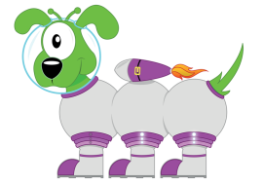
Target Boards

Slide 26
Target Boards
Counting and Reading Numbers

Slide 28

How many?

Slide 29
2

Slide 30
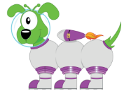
2
How many?

Slide 31

4
2
How many?

Slide 32
4
2

Slide 33
4
How many?
2
6

Slide 34
4
2
6

Slide 35
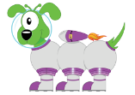
4
How many?
2
6
8

Slide 36
4
2
6
3
8

Slide 37
How many?
4
2
6
3
8

Slide 38
4
2
9
6
3
8

Slide 39
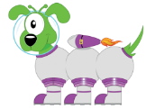
How many?
4
2
9
6
3
8

Slide 40
5
4
2
9
6
3
8

Slide 41
How many?
5
4
2
9
6
3
8

Slide 42
5
4
2
9
6
3
8
1

Slide 43

5
4
2
9
6
3
8
1

Slide 44
5
4
7
2
9
6
3
8
1

Slide 45
Target Boards
Reading Numbers to 20

Slide 46
10
8
5
18
4
9
20
13
3
6
16
12
15
7
19
1
2
17
11
14

Slide 47
Target Boards
Reading Multiples of 10

Slide 48
80
30
90
120
60
10
20
100
40
110
50
70

Slide 49
Target Boards
Counting and Reading Numbers

Slide 50
3
8
7
5
9
2
10
6
1
4

Slide 51
Target Boards
Reading Numbers

Slide 52
21
22
23
24
25
20
19
18
17
16
11
12
13
14
15
10
9
8
7
6
1
2
3
4
5

Slide 53
21
23
25
19
17
11
11
13
15
9
7
1
3
5

Slide 54
22
24
20
18
16
12
14
10
8
6
2
4

Slide 55
8
6
21
25
19
16
3
18
17
5
9
24
4
14
23
12
1
10
7
15
20
2
13
11
22

Slide 56
Learn Its
L
Learn Its

Slide 57

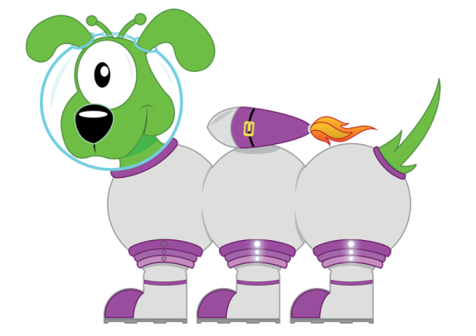
Get your whiteboards ready!!

Slide 58

Let’s wire the numbers up!!
4
+-
2
2

Slide 59
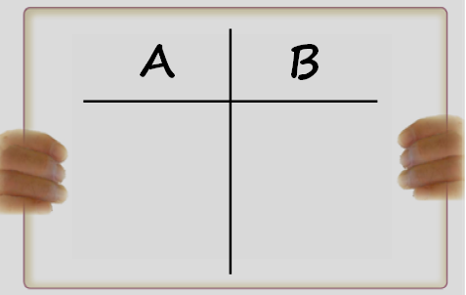
Let’s wire the numbers up!!
4
4
+-
2
2

Slide 60
Let’s wire the numbers up!!
6
+-
3
3

Slide 61
Let’s wire the numbers up!!
6
6
+-
3
3

Slide 62
Let’s wire the numbers up!!
8
+-
4
4

Slide 63
Let’s wire the numbers up!!
8
8
+-
4
4

Slide 64
Let’s wire the numbers up!!
10
+-
5
5

Slide 65
Let’s wire the numbers up!!
Double five
is ten!
10
10
+-
5
5

Slide 66
Let’s wire the numbers up!!
5
+-
2
3

Slide 67
Let’s wire the numbers up!!
5
5
+-
2
3

Slide 68
Let’s wire the numbers up!!
5
+-
2
3

Slide 69
Let’s wire the numbers up!!
3
5
+-
2
3

Slide 70
Let’s wire the numbers up!!
5
+-
2
3

Slide 71
Let’s wire the numbers up!!
2
5
+-
2
3

Slide 72
Get your whiteboards ready!!

Slide 73

What is the switcher?
2+1=3

Slide 74
1+2=3

Slide 75
Get your whiteboards ready!!

Slide 76
What is the switcher?
2+3=5

Slide 77
3+2=5

Slide 78
2 + 2 = 4

Slide 79
2 + 2 = 4

Slide 80
3 + 3 = 6

Slide 81
3 + 3 = 6

Slide 82
4 + 4 = 8

Slide 83
4 + 4 = 8

Slide 84
5 + 5 = 10

Slide 85
5 + 5 = 10

Slide 86
2 + 3 = 5

Slide 87
2 + 3 = 5

Slide 88


Its Nothing New
Jigsaw Numbers
I
It’s Nothing New

Slide 89
What is the missing piece to five?
Jigsaw Numbers.

Slide 90
Get your whiteboards ready!!

Slide 91
What is the missing piece to five?
4
How many more to make five?

Slide 92
1
Because 4+1=5
And 1+4=5

Slide 93
Get your whiteboards ready!!

Slide 94
What is the missing piece to five?
3
How many more to make five?

Slide 95
2
Because 3+2=5
And 2+3=5

Slide 96
Get your whiteboards ready!!

Slide 97
What is the missing piece to five?
0
How many more to make five?

Slide 98
5
Because 0+5=5

Slide 99
Get your whiteboards ready!!

Slide 100
What is the missing piece to five?
2
How many more to make five?

Slide 101
3
Because 2+3=5
And 3+2=5

Slide 102
Some outer numeracy!
What else do you know?
5
+, -
2
3

Slide 103
total
less than
3
take away
difference
more than
minus
2
3
plus
sum

Slide 104
The total of 3
and 2 is 5
5 take away 3 is 2
The sum of 20
and 30 is 50

Slide 105

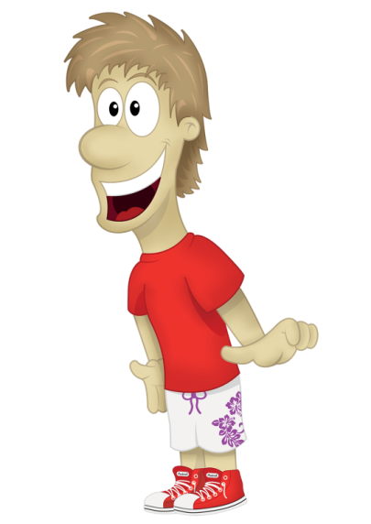


CLIC
Session
C
Calculation

