Slide 1
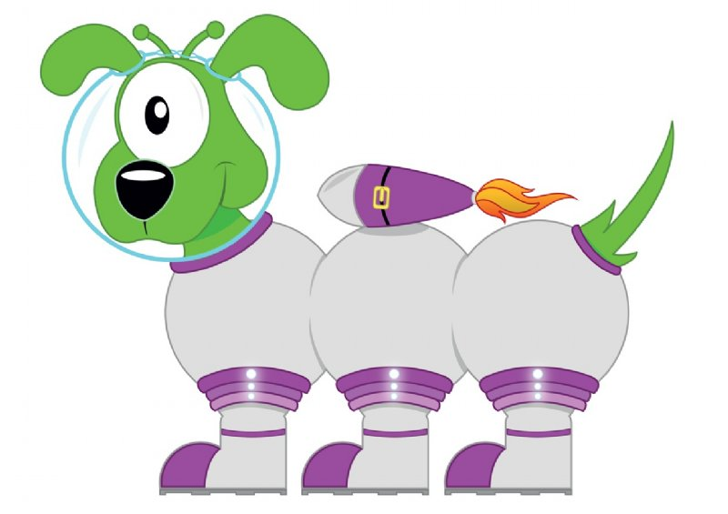
Squiggleworth
64.2
60
4
0.2

Slide 2
Squiggleworth
18.9
10
8
0.9

Slide 3
Squiggleworth
60.9
60
0
0.9

Slide 4
Squiggleworth
5.61
5
0.6
0.01

Slide 5
Squiggleworth
6.95
6
0.9
0.05

Slide 6
Squiggleworth
4.07
4
0
0.07

